Slide 1
SVM

Slide 2
Support Vector Machine (SVM)
Support vector machine is a supervised learning system and used for classification and regression problems.
Support vector machine is extremely favored by many as it produces notable correctness with less computation power.
It can solve linear and non-linear problems
The idea of SVM is simple: The algorithm creates a line or a hyperplane which separates the data into classes.

Slide 3
SVM
Support vector machines are a set of supervised learning methods used for classification, regression, and outliers detection.
SVMs are used in applications like handwriting recognition, intrusion detection, face detection, email classification, gene classification, and in web pages. This is one of the reasons we use SVMs in machine learning. It can handle both classification and regression on linear and non-linear data..
There are specific types of SVMs you can use for particular machine learning problems, like support vector regression (SVR) which is an extension of support vector classification (SVC).

Slide 4
How an SVM works?
A simple linear SVM classifier works by making a straight line between two classes.
That means all of the data points on one side of the line will represent a category and the data points on the other side of the line will be put into a different category.
SVMs are different from other classification algorithms because of the way they choose the decision boundary that maximizes the distance from the nearest data points of all the classes.
The decision boundary created by SVMs is called the maximum margin classifier or the maximum margin hyper plane.

Slide 5
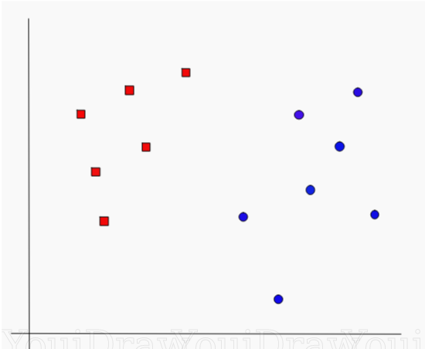
Hyperplane?

Slide 6
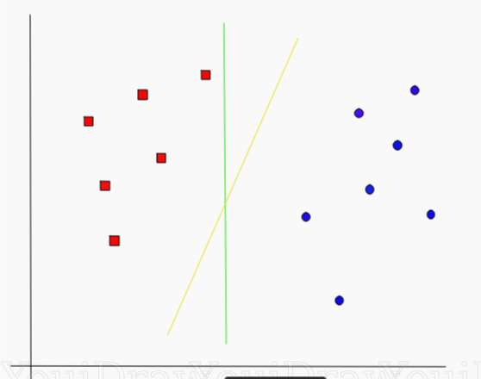
Which line according to you best separates the data??

Slide 7
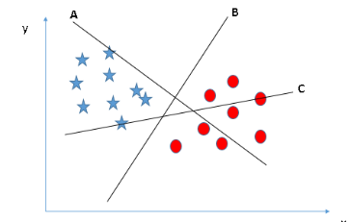
How can we identify the right hyper-plane?
You need to remember a thumb rule to identify the right hyper-plane: “Select the hyper-plane which segregates the two classes better”. In this scenario, hyper-plane “B” has excellently performed this job.

Slide 8
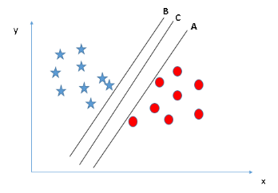
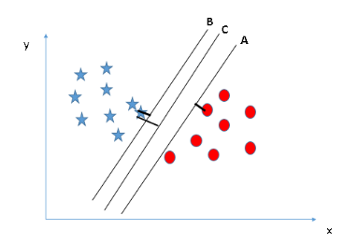
Identify the right hyper-plane (Scenario-2):
Here, maximizing the distances between nearest data point (either class) and hyper-plane will help us to decide the right hyper-plane. This distance is called as Margin. Let’s look at the below snapshot:
Above, you can see that the margin for hyper-plane C is high as compared to both A and B. Hence, we name the right hyper-plane as C. Another lightning reason for selecting the hyper-plane with higher margin is robustness. If we select a hyper-plane having low margin then there is high chance of miss-classification.

Slide 9
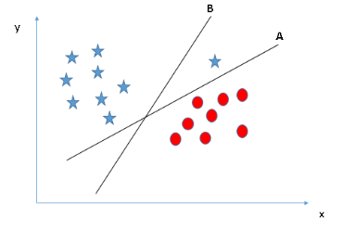
Identify the right hyper-plane (Scenario-3)
Some of you may have selected the hyper-plane B as it has higher margin compared to A. But, here is the catch, SVM selects the hyper-plane which classifies the classes accurately prior to maximizing margin. Here, hyper-plane B has a classification error and A has classified all correctly. Therefore, the right hyper-plane is A.

Slide 10
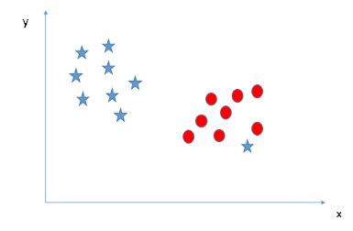
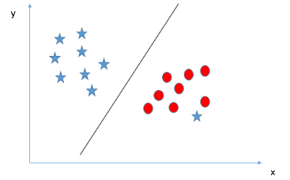
Can we classify two classes (Scenario-4)?:
As I have already mentioned, one star at other end is like an outlier for star class. The SVM algorithm has a feature to ignore outliers and find the hyper-plane that has the maximum margin. Hence, we can say, SVM classification is robust to outliers.

Slide 11
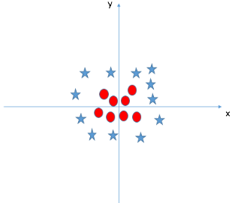
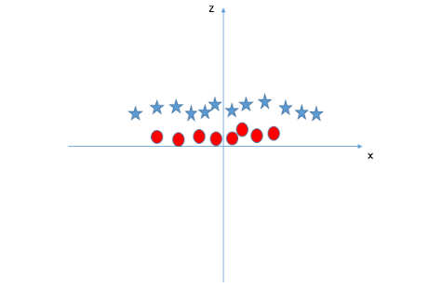
Find the hyper-plane to segregate to classes (Scenario-5):
SVM can solve this problem. Easily! It solves this problem by introducing additional feature. Here, we will add a new feature z=x^2+y^2. Now, let’s plot the data points on axis x and z:
In above plot, points to consider are:
All values for z would be positive always because z is the squared sum of both x and y
In the original plot, red circles appear close to the origin of x and y axes, leading to lower value of z and star relatively away from the origin result to higher value of z.
should we need to add this feature manually to have a hyper-plane?
NO

Slide 12
Kernel
SVM algorithm has a technique called the kernel trick. The SVM kernel is a function that takes low dimensional input space and transforms it to a higher dimensional space i.e. it converts not separable problem to separable problem.
It is mostly useful in non-linear separation problem. Simply put, it does some extremely complex data transformations, then finds out the process to separate the data based on the labels or outputs you’ve defined.

Slide 13
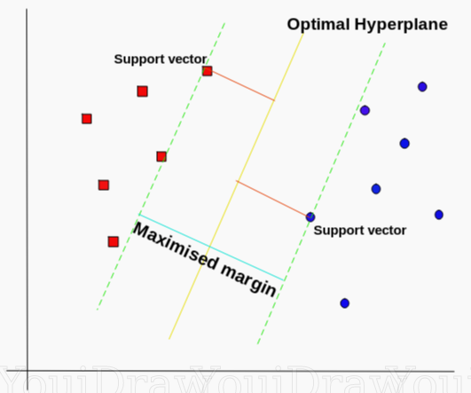
SVM’s way to find the best line
Optimal Hyperplane using the SVM algorithm

Slide 14
Hyperplane
A hyperplane in an n-dimensional Euclidean space is a flat, n-1 dimensional subset of that space that divides the space into two disconnected parts.
According to the SVM algorithm we find the points closest to the line from both the classes.
These points are called support vectors. Now, we compute the distance between the line and the support vectors.
This distance is called the margin. Our goal is to maximize the margin. The hyperplane for which the margin is maximum is the optimal hyperplane.
Thus SVM tries to make a decision boundary in such a way that the separation between the two classes(that street) is as wide as possible.

Slide 15
Pros of Using SVM
Effective on datasets with multiple features, like financial or medical data.
Effective in cases where number of features is greater than the number of data points.
Uses a subset of training points in the decision function called support vectors which makes it memory efficient.
Different kernel functions can be specified for the decision function. You can use common kernels, but it's also possible to specify custom kernels.

Slide 16
Cons of using SVM
It doesn’t perform well when we have large data set because the required training time is higher
It also doesn’t perform very well, when the data set has more noise i.e. target classes are overlapping
SVM doesn’t directly provide probability estimates, these are calculated using an expensive five-fold cross-validation. It is included in the related SVC method of Python scikit-learn library.
.

Slide 17
Math behind SVM
Basic Linear Algebra:
Vectors
Length of Vectors
Direction of Vectors
Dot Product
Hyperplane

Slide 18
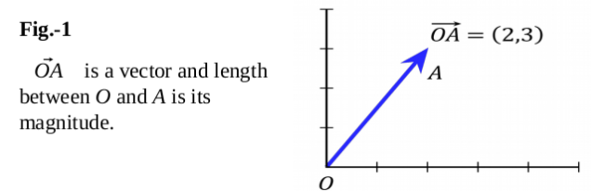
Vectors
Vectors are mathematical quantity which has both magnitude and direction.
A point in the 2D plane can be represented as a vector between origin and the point.

Slide 19
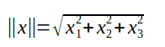
Length of Vectors
Length of vectors are also called as norms. It tells how far vectors are from the origin.
Length of vector x(x1,x2,x3) is calculated as:

Slide 20
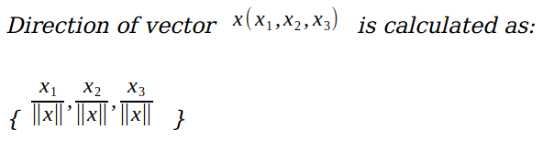
Direction of vectors

Slide 21
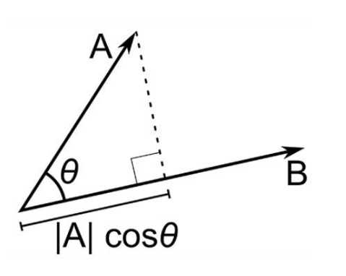
Dot Product
A . B = |A| cosθ * |B|
Where |A| cosθ is the projection of A on B
And |B| is the magnitude of vector B
Now in SVM we just need the projection of A not the magnitude of B
To just get the projection we can simply take the unit vector of B because it will be in the direction of B but its magnitude will be 1. Hence now the equation becomes:
A.B = |A| cosθ * unit vector of B

Slide 22
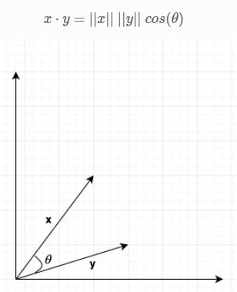
Dot Product
Dot product between two vectors is a scalar quantity . It tells how to vectors are related. The dot product can be defined as the projection of one vector along with another, multiply by the product of another vector.

Slide 23
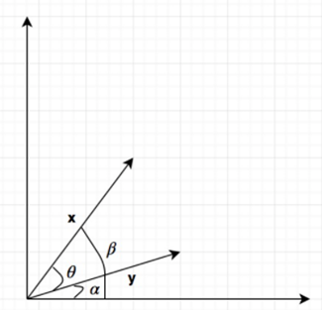
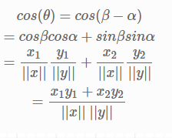
Dot Product

Slide 24
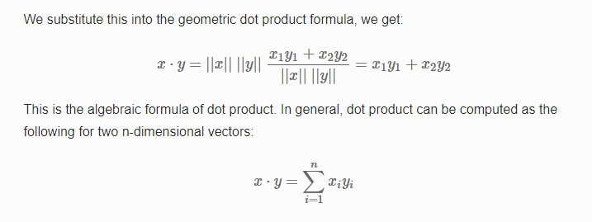
Dot Product

Slide 25
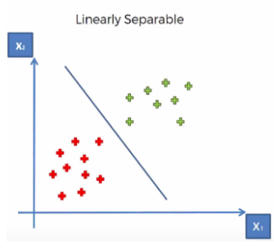
Hyper-plane
It is plane that linearly divide the n-dimensional data points in two component.
In case of 2D, hyperplane is line, in case of 3D it is plane. It is also called as n-dimensional line.

Slide 26
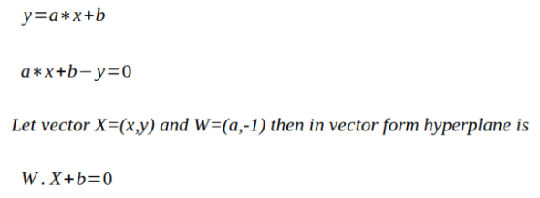
Linearly Separable
Hyperplane is line divides data point into two classes(red & green), written as:

Slide 27
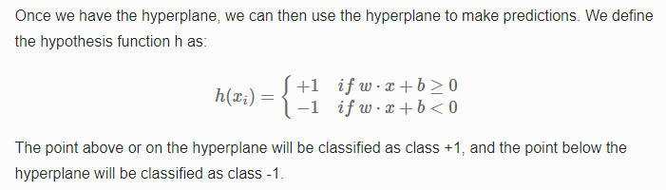
Classifier

Slide 28
Hyperplane
A hyperplane is a generalization of a plane:
in two dimensions, it’s a line.
in three dimensions, it’s a plane.
in more dimensions, you can call it a hyperplane.

Slide 29
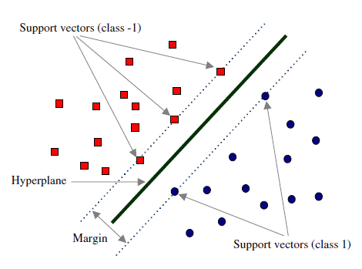
How to choose Optimal Hyperplane ?
In SVM our goal is to choose an optimal hyperplane which maximizes the margin.

Slide 30
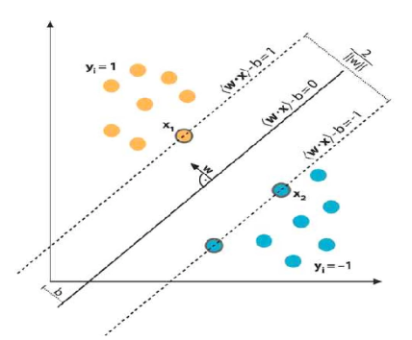
Mathematical Interpretation of Optimal Hyperplane

Slide 31

Contd..

Slide 32
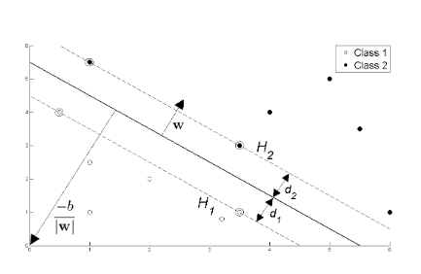
Classification

Slide 33
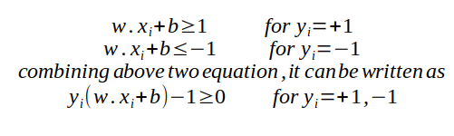
SVM Classification
We have two hyperplane H1 and H2 passing through the support vectors of +1 and -1 class respectively. so
w.x+b=-1 :H1
w.x+b=1 :H2

Slide 34
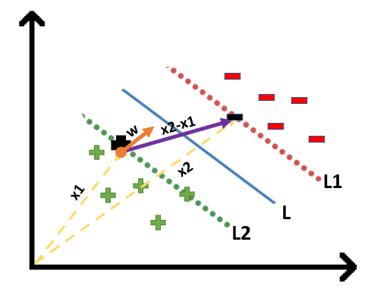
Suppose a green point is correctly classified that means it will follow w.x+b>=1, if we multiply this with y=1 we get this same equation mentioned above. Similarly, if we do this with a red point with y=-1 we will again get this equation w.x+b<=-1.
We will take 2 support vectors, 1 from the negative class and 2nd from the positive class. The distance between these two vectors x1 and x2 will be (x2-x1) vector. What we need is, the shortest distance between these two points which can be found using a trick we used in the dot product. We take a vector ‘w’ perpendicular to the hyperplane and then find the projection of (x2-x1) vector on ‘w’. This project can be found by dot product of vectors

Slide 35
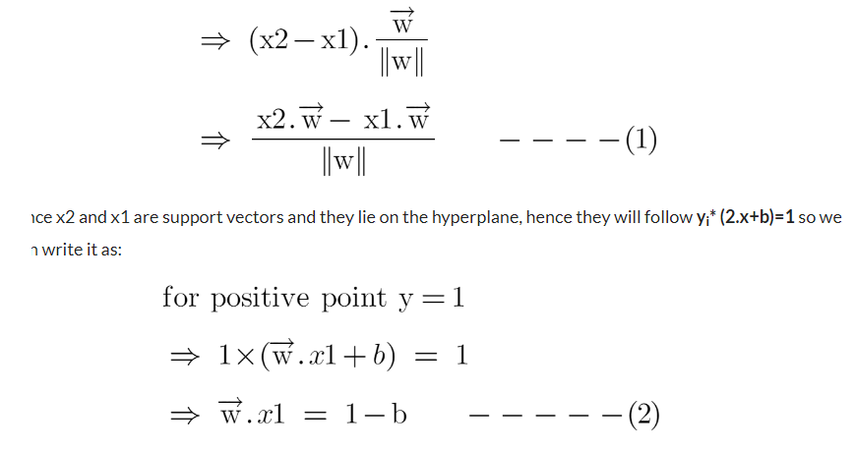

Slide 36
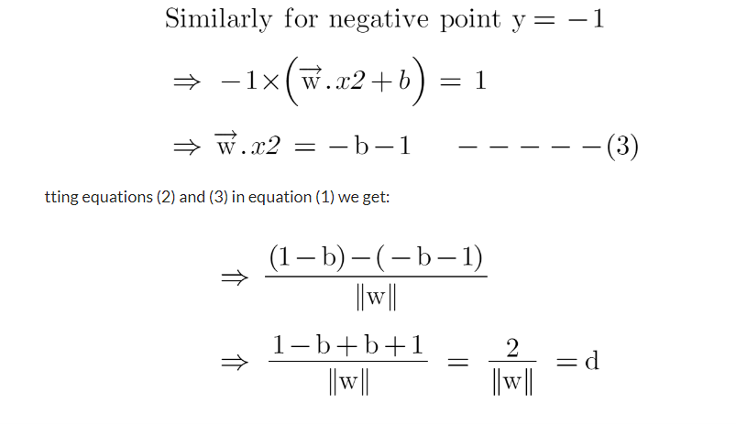

Slide 37
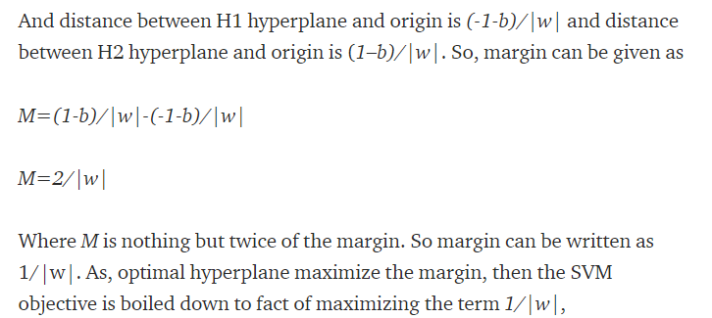
Margin

Slide 38
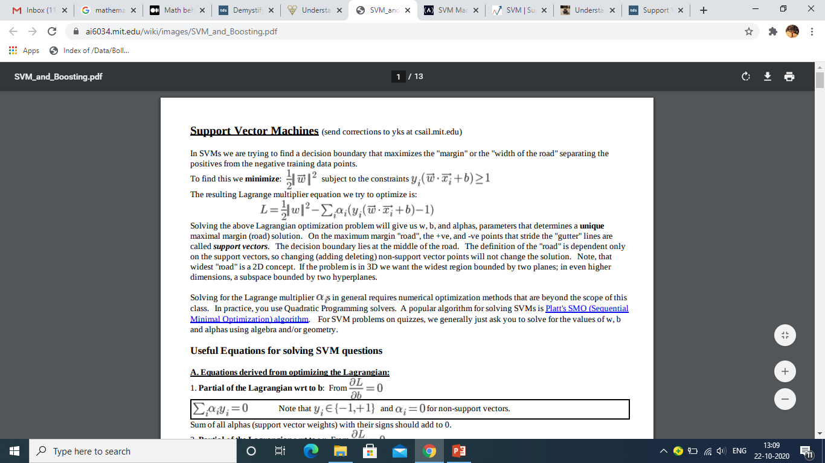
SVM

Slide 39
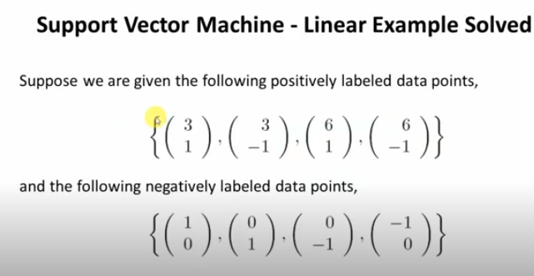

Slide 40
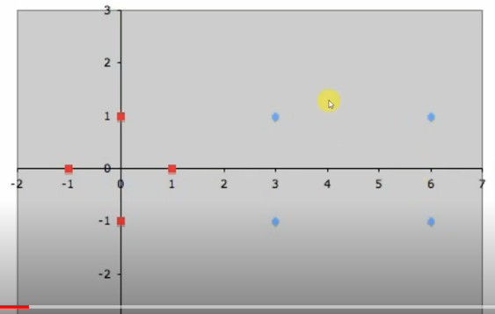

Slide 41
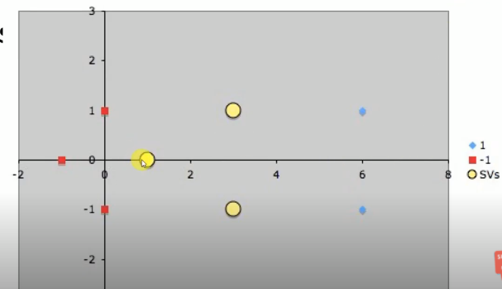
Finding Support Vectors

Slide 42
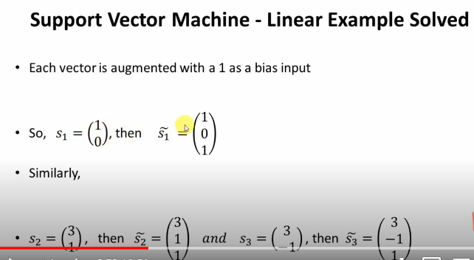

Slide 43
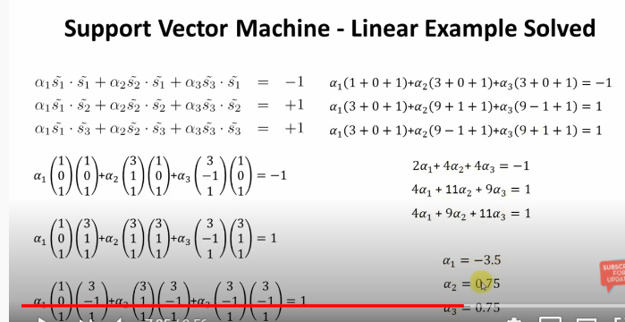
Finding alpha1, alpha2 and alpha3

Slide 44
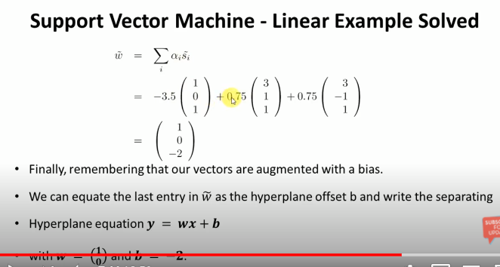
Weight vector and Bias

Slide 45
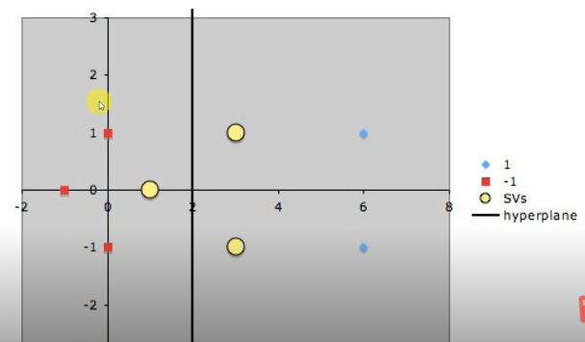
HyperPlane

Slide 46
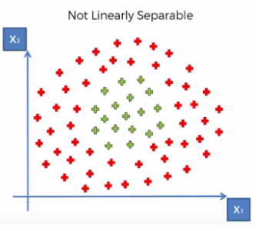
What if data points is not linearly separable ?

Slide 47
Non-Linear Data Points
How can we separate the data-points linearly?
This type of situation comes very often in machine learning world as raw data are always non-linear here.
So, Is it do-able? yes!!. we will add one extra dimension to the data points to make it separable.

Slide 48
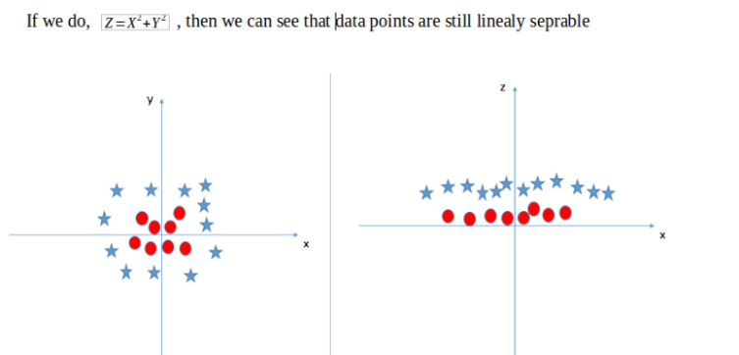
Non-Linear Data Points
so , the above process of making non-linearly separable data point to linearly separable data point is also known as Kernel Trick

Slide 49
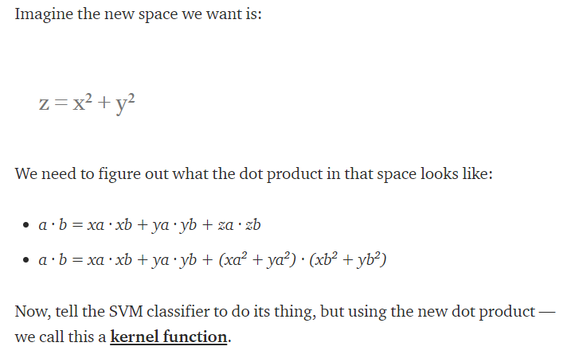
Kernel Function

Slide 50
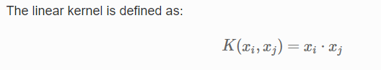
Kernel Functions (Linear)
These are commonly recommended for text classification because most of these types of classification problems are linearly separable.
The linear kernel works really well when there are a lot of features, and text classification problems have a lot of features. Linear kernel functions are faster than most of the others and you have fewer parameters to optimize.
Here's the function that defines the linear kernel:

Slide 51
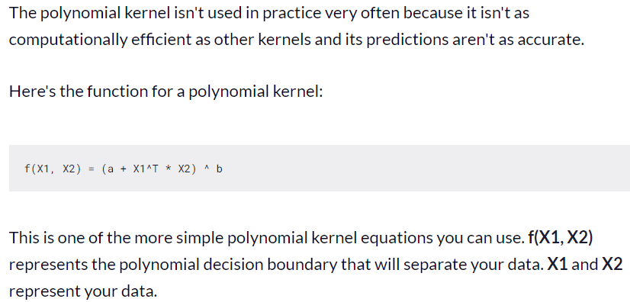
Kernel Functions (Polynomial)
b is number of dimensions

Slide 52
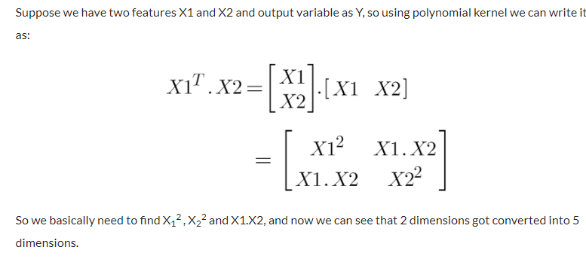

Slide 53
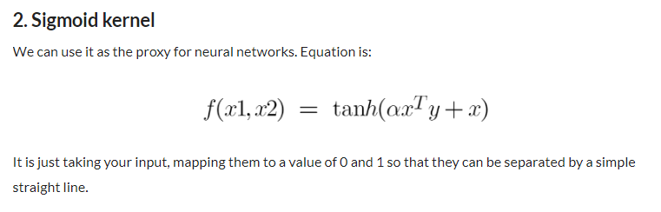
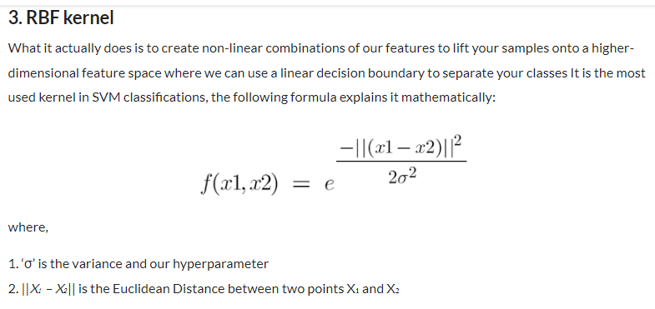

Slide 54
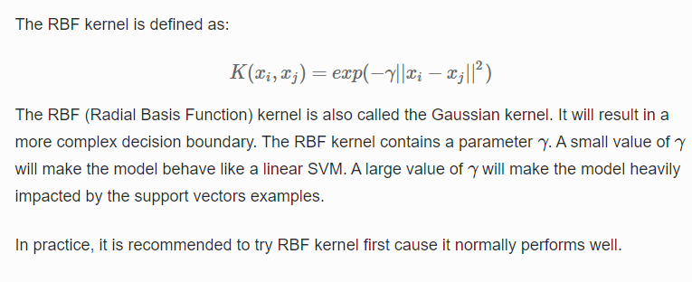
Kernel Functions (Gaussian Radial Basis Function (RBF))

Slide 55
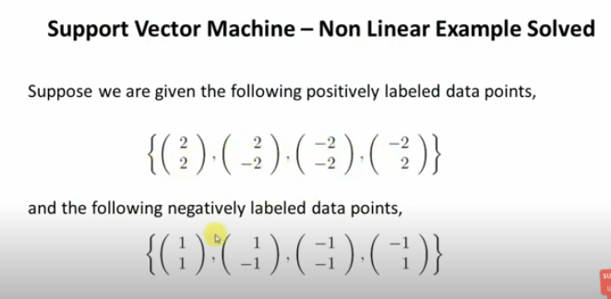
Non Linear Example

Slide 56
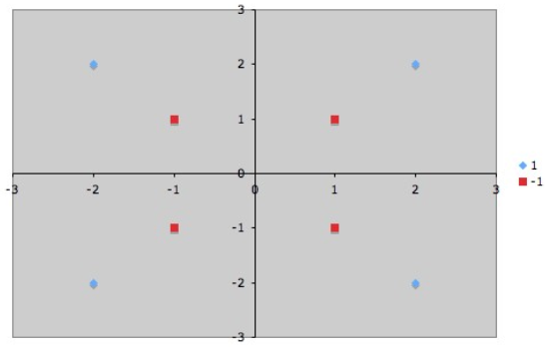

Slide 57
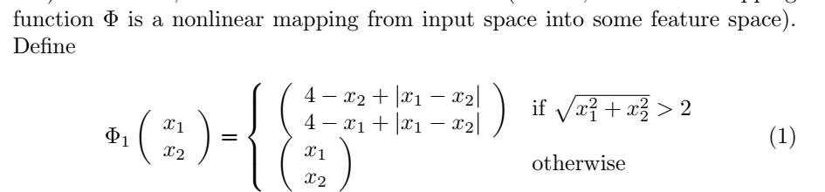

Slide 58


Slide 59




Slide 60


Slide 61


Slide 62


Slide 63




Slide 64

Using SVM

Slide 65


Slide 66
References
https://shuzhanfan.github.io/2018/05/understanding-mathematics-behind-support-vector-machines/
https://www.youtube.com/watch?v=ivPoCcYfFAw&feature=youtu.be
https://www.analyticsvidhya.com/blog/2021/10/support-vector-machinessvm-a-complete-guide-for-beginners/
https://www.analyticsvidhya.com/blog/2017/09/understaing-support-vector-machine-example-code/

